Slide 1
MOEDL TRAINING USING CLASSIFICATION

Slide 2
Dataset
The dataset consist of 1026 entries on which model is trained
It consist of 13 independent variables
Age
sex
cp
trestbps
chol
Fbs
restecg
Thalach
exang
oldpeak
slope
ca
thal
And one dependent variable target (0,1)

Slide 3
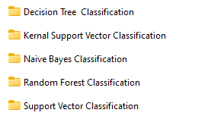
The following models of regression are trained on this dataset

Slide 4
Point covered in EDA
Initial Data Exploration
Feature Distribution Analysis Before Scaling
Apply Feature Scaling
Model Training and Evaluation
Plot feature distributions after scaling

Slide 5
#Explanation of the EDA Steps
Initial Data Exploration:
Descriptive Statistics: Shows basic statistics (mean, std, min, max) for each feature.
Info and Head: Provides information about data types, non-null counts, and a preview of the first few rows.
Feature Distribution Analysis Before Scaling:
Histograms with KDE: Visualizes the distribution of each feature before scaling, which helps in understanding the range and spread of feature values.
Feature Scaling Impact:
Scaling:Applies StandardScaler to standardize features so they have a mean of 0 and a standard deviation of 1.
Post-Scaling Histograms: Plots the distributions of features after scaling, verifying that they are standardized.
Model Performance Comparison:
Model Training and Evaluation (Before Scaling): Trains an SVM model on the original data and evaluates its performance.
Model Training and Evaluation (After Scaling): Trains an SVM model on the scaled data and evaluates its performance.
Comparison: Compares the accuracy, confusion matrix, and classification report before and after scaling to assess the impact of scaling on model performance.
This comprehensive EDA helps you understand the data distributions, the effect of scaling, and how feature scaling impacts the performance of your
SVM model.

Slide 6


Slide 7
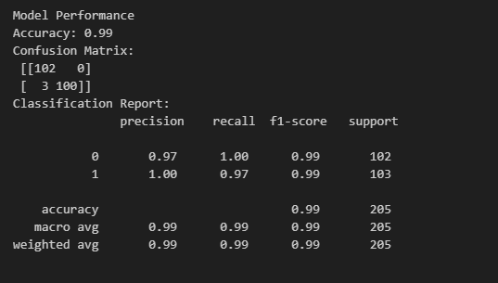
1.Decision Tree Classification

Slide 8
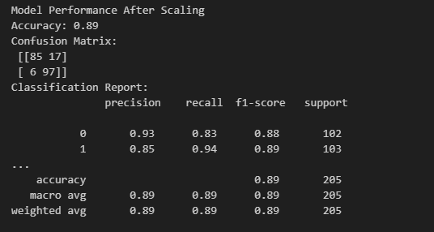
2.Support Vector Classification

Slide 9
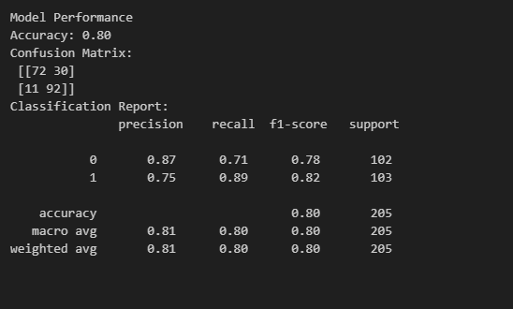
3.Naïve Bayes Classification

Slide 10
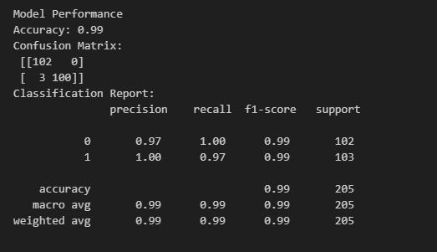
4.Random Forest Classification

Slide 11
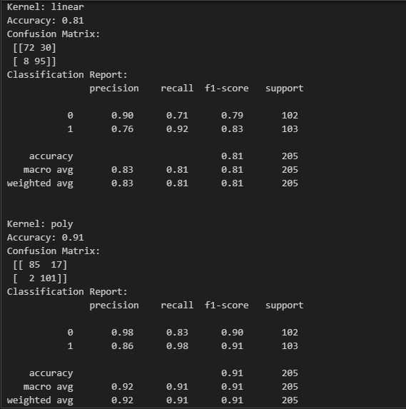
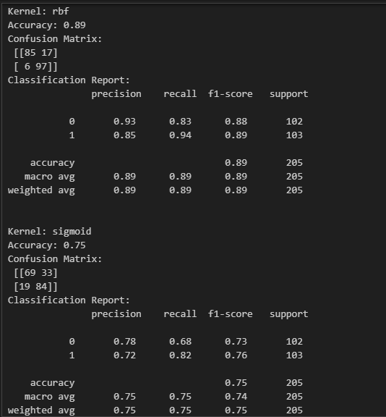
5.Kernal Support Vector

